Slide 1

Kaggle challenge 1
Muhammad Mujtaba Afzal
14882

Slide 2
Main agenda
Data preparation
Models
Best score model

Slide 3
Data preparation
Column Filter: to filter columns that did not contributed to improvement in ROC.
Number to string: convert the TARGET_CLASS to string and make data categorical.
Rule based Row-Filter: to filter out rows from training data having attribute category that did not have a corresponding category in test data.
Partitioning: to divide the training data to first test the model ROC before making prediction on the test data.

Slide 4
Model#1
The first model used was decision tree.
The best score reached was 0.56159.
Configurations changed were:
Quality measure= gain ratio
Pruning method= MDL
Min Number of records per node=1

Slide 5
Model#2
The second model used was Naïve Bayes.
The best score reached was 0.63856.
Did not work much on Naive Bayes.

Slide 6
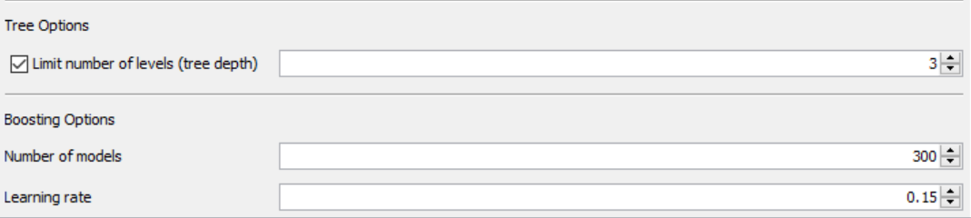
Model#3
The next model used was Gradient Boosted Trees Predictor.
The best score was 0.69548.
Tree depth was limited to avoid over fitting.

Slide 7
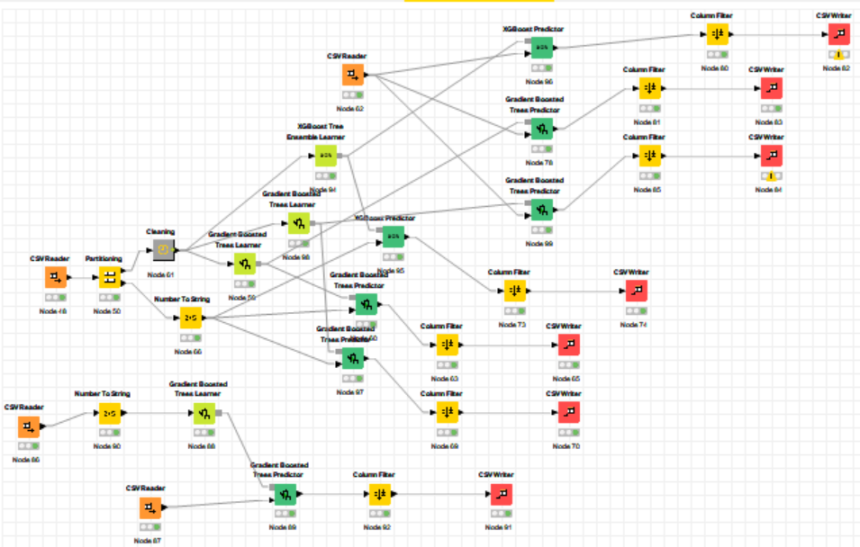
Other approaches
Next I tried different approaches like:
Stacking(Knime file included)
Partition training data into A and B.
Train model 0 on A and make predictions on B and C and store them as B1 and C1.
Train model 1 on A and make predictions on B and C and store them in B1 and C1.
Train model 3 on A and make predictions on B and C and store them in B1 and C1.
Train model 4 on B1 and predict on C1.
Here model 1, 2 and 3 are base learners and model 4 is meta learner.

Slide 8
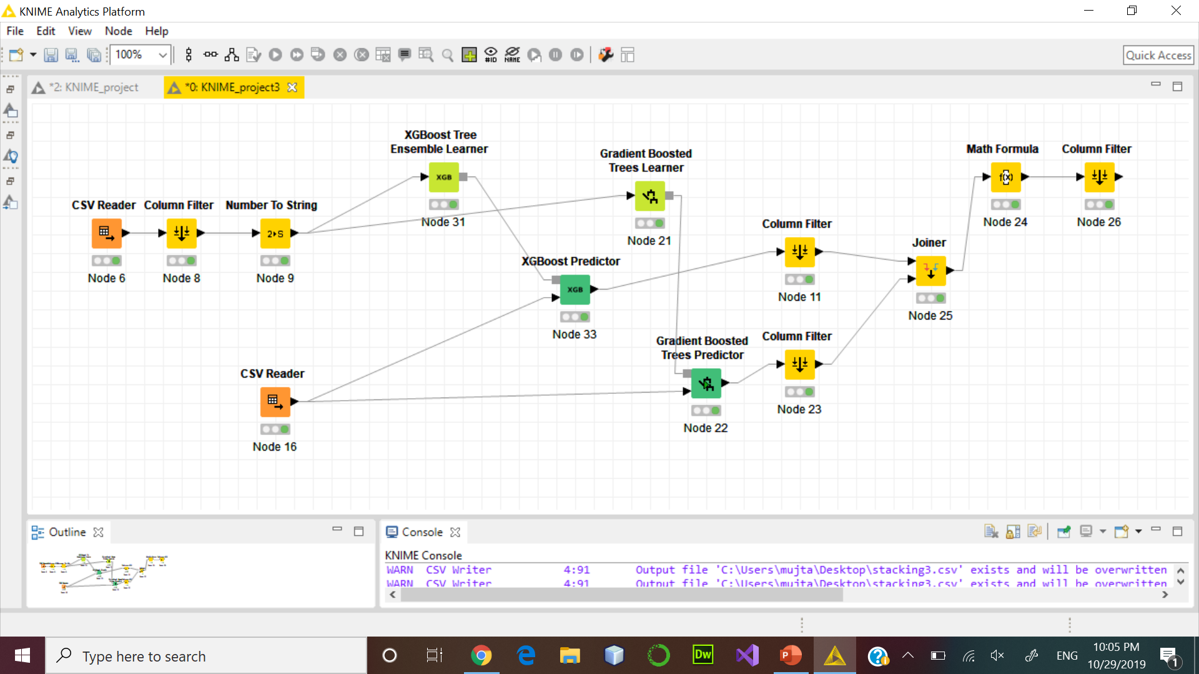
Other approaches
Taking average of predictions from different models

Slide 9
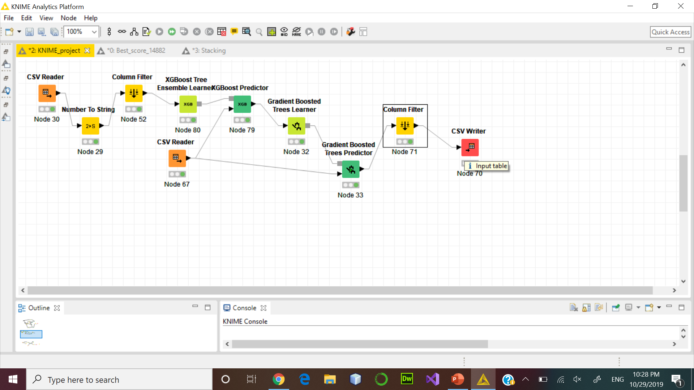
Learning a model from predictions of another model
Gave a kaggle score of 0.67541.

Slide 10
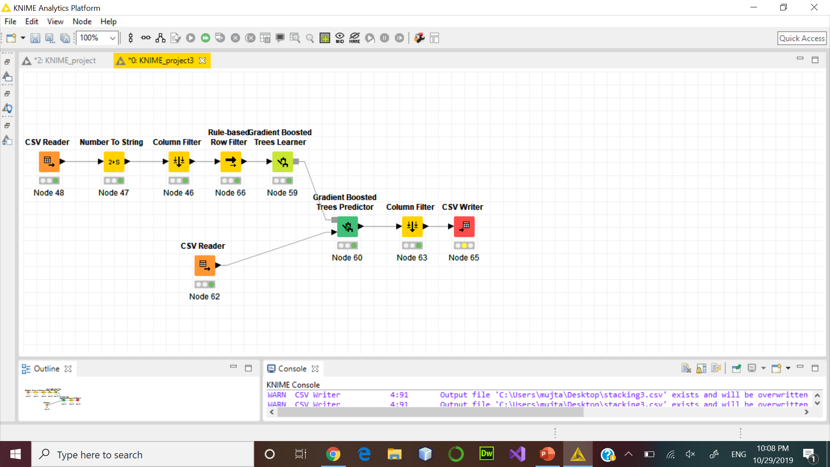
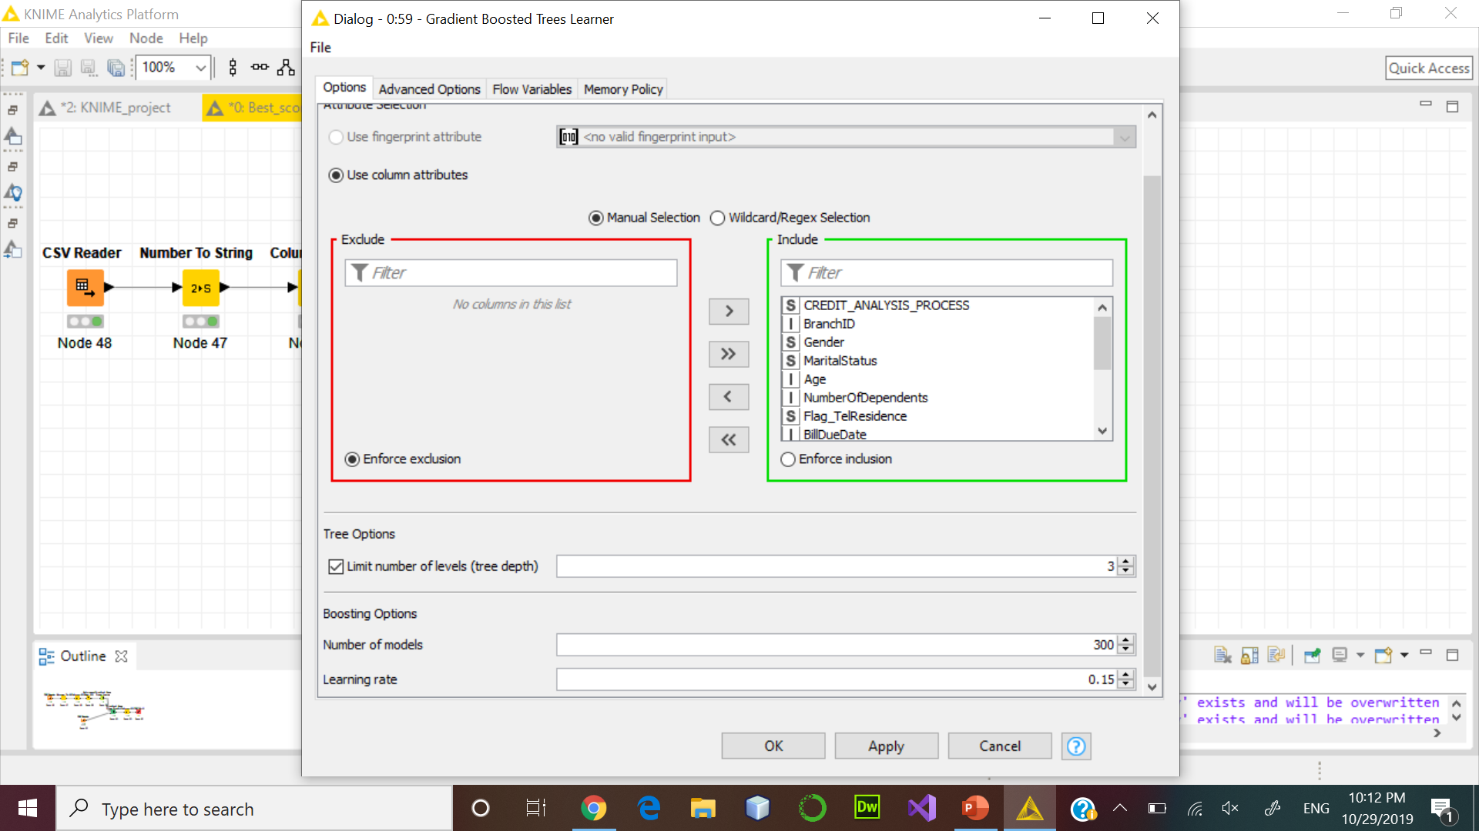
Best score model
The best score model was the gradient boosted model.

